Slide 1
3.0 Matrix Analysis of Networks
EE1203 – Theory of Electricity
Prof J. Rohan Lucas
lucas@kdu.ac.lk
Department of Electrical, Electronic & Telecommunication Engineering
General Sir John Kotelawala Defence University
September 2020

Slide 2
Learning Outcomes
On completion of module, student will be able to
LO1: Analyse the performances of AC circuits
Analyse circuits using nodal and mesh theory
LO2: Analyse two port networks using different models.
LO3: Analyse transfer functions of RLC networks for transients.
LO4: Analyse waveforms for its harmonics.
LO5: Perform calculations in three phase circuits including unbalanced waveforms.
t
Notes:
.

Slide 3
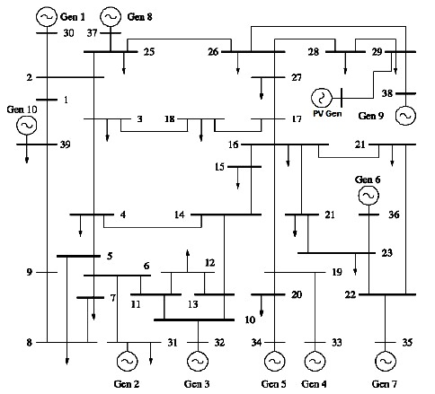
Matrix Analysis of Networks
Large networks are
tedious to analyse using normal equations
more convenient to formulate in matrix form.
Gives a compact and neat form of solution.
necessary to know the structure of a network
formulate the problem based on the structure

Slide 4
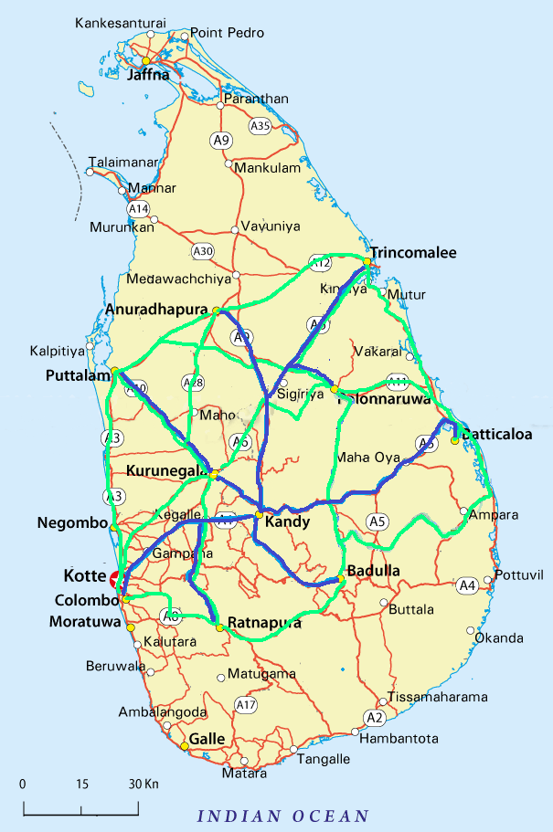
Topology
Deals with structure of interconnected system.
Formulates the problem based on non-measurable geometric properties of network.
Interconnection of elements completely characterises
number of independent loop currents
number of independent node-pair voltages
Radial Road Network from Kandy to Colombo, Puttalam, Anuradhapura, Trincomalee, Polonnaruwa, Batticaloa, Badulla and Ratnapura
Mesh Network between same cities without touching Kandy

Slide 5
Structure of the network
R₁
C
L₁
(a)
(b)
Figure 1 – Structure of the network
1(a) and (b) have the same structure (topology).
However, as can be seen, elements are quite different.

Slide 6
Graph of Network
Circuit of figure 2(a) also has the same topology as figures 1(a) and 1(b).
Figure 2(b) shows structure corresponding to all 3 circuits.
(a) Network
(b) Graph of Network
Figure 2
Does not indicate any of the elements in the networks.
Known as the graph of the network
– Has all the nodes of the original network
In obtaining the graph,
each element of the network is represented by a line
each voltage source by a short-circuit
and each current source by an open circuit.

Slide 7

Tree of a Network



Which line diagrams would represent a normal tree (without leaves) ? and why ?
Only first diagram would fully satisfy the requirements.
Second diagram has branches closing on itself
only a tree like Nuga might appear to close on itself
Third diagram has branches in mid air not joined to main tree.

Slide 8
Properties associated with trees
All branches must be part of the tree
There cannot be closed loops formed from branches
There cannot be branches isolated from the tree
Same properties apply in defining a tree of a network
can be many trees associated with a given network.
need not have a trunk coming from the ground and branches coming from the trunk.
a reduced graph of network with some of the links removed so as to leave all the nodes connected together, but not to have any loop left.

Slide 9
Possible trees for the Graph
Graph of Network
Some of the possible trees
When tree is removed from graph, what remains is called co-tree
Co-tree is graph of removed links –compliment of the tree.
A co-tree may contain closed loops, and disconnected branches.

Slide 10
Analysis of structure of network
A single branch is required to join two nodes.
Node 1
Node 2
Joining each additional node would require an additional branch.
Node 1
Node 2
New Node
Let b = number of branches in the network
n = number of nodes in the network
l = number of independent loops
Then, number of branches in tree = n – 1
number of links removed = b – (n – 1) = b – n + 1

Slide 11
Formation of Independent Loops
If any one of removed links is added to the tree, then a new loop is formed.
∴ number of links removed from graph to form the tree is equal to the number of independent loops.
l = b – n + 1

Slide 12
Oriented Graph
1
Graph of a Network
Branches numbered with assigned directions to currents.
Voltage considered to increase in direction opposite to flow of current
2
3
4
5
6
Oriented Graph

Slide 13
Matrix Analysis of Networks
To solve circuit problems,
need to write the equations corresponding to
Ohm’s Law, and
Kirchoff’s Current Law
Kirchoff’s Voltage Law
Same is true even when there are a large number of branches.
use matrix analysis

Slide 14
Kirchoff’s current Law in matrix form
For any node k
− i₁ − i₂ − i₄ + i₆ + i₇ = 0
or
i₁ + i₂ + i₄ = i₆ + i₇
or
i₁ + i₂ + i₄ – i₆ – i₇ = 0
or
+1 . i₁ + 1 . i₂ + 0 .i₃ + 1 .i₄ + 0 . i₅ – 1 .i₆ – 1 .i₇ = 0
Last form is preferred for matrix implementation
all currents in network are included in equation with different coefficients.
i₃
+1
i₇
-1
0
i₁
k
-1
i₆
i₅
i₂
+1
0
+1
i₄

Slide 15
For Computer Implementation
There must be a unique way of obtaining the coefficients a_{jk}.
I_{j} – current in j^{th} branch
j^{th} branch
directed away from k^{th} node: a_{jk} = +1
directed towards k^{th} node: a_{jk} = –1
not incident on the k^{th} node: a_{jk} = 0
Kirchoff’s current law may be written, for the k^{th} node
a_{1k} . i₁ + a_{2k} . i₂ + a_{3k} . i₃ + a_{4k} . i₄ + ...... ....... ..... a_{7k} . i₇ = 0 or
at k^{th} node, for all k

Slide 16
Collection of equations, for each node k, would give
In [A]^{t}, row vectors are dependant, since sum is zero.
[A]^{t} written with one row less, giving only (n-1) rows.
[A]^{t} – node-branch incidence matrix, (n-1)×b.
[A] – branch-node incidence matrix, b× (n-1)
a_{jk} = +1 if j^{th} current is directed away from the k^{th} node
a_{jk} = −1 if j^{th} current is directed towards the k^{th} node
a_{jk} = 0 if j^{th} current is not incident on the k^{th} node

Slide 17
Kirchoff’s voltage Law in matrix form
0
+1
0
0
-1
0
for s^{th} loop, for all s;
where b_{rs} = −1, 0, or +1
-1
s
-1
0
+1
0
0
[B]^{t} – mesh-branch incidence matrix, (l×b)
[B] – branch-mesh incidence matrix, (b×l)
b_{rs} = +1 if r^{th} current is in same direction as s^{th} loop
b_{rs} = −1 if r^{th} current is in opposite direction to s^{th} loop
b_{rs} = 0 if r^{th} current is in the not part of the s^{th} loop

Slide 18
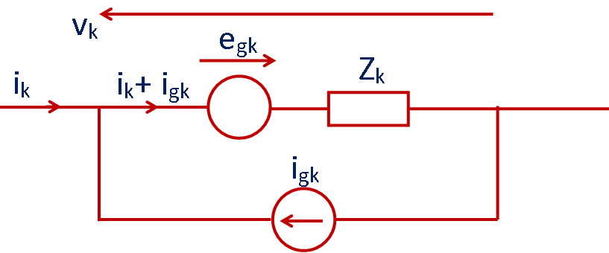
Ohm’s Law in matrix form
Figure - General branch
for all branches k = 1, 2, .... ... b
v_{k} = – e_{gk} + Z_{k} i_{gk} + Z_{k} i_{k}
Either voltage source or current source would normally be used.

Slide 19
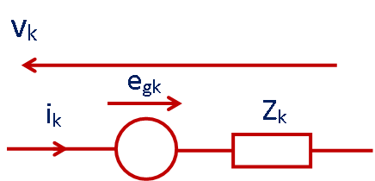
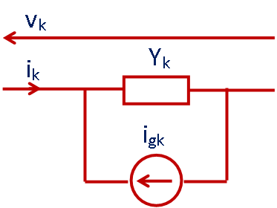
Conversion to either voltage source or current source only
Conversion with either Thevenin’s Theorem or Norton’s Theorem.
With a voltage source only v_{k} = – e_{gk} + Z_{k} i_{k}
for all branches k = 1, 2, ....... b
and in matrix form as
With a current source only
i_{k} = Y_{k} v_{k} – i_{gk}
for all branches k = 1, 2, .... ... b
and in matrix form as
, where [Y_{b}] = [Z_{b}]⁻¹

Slide 20
In Summary
From Kirchoff’s Laws
(1) (n-1) independent equations
(2) l independent equations
and from Ohm’s Law
(3) b independent equations or
(3)* b independent equations
Thus total number of independent equations is
n – 1 + l + b = b + b = 2 b

Slide 21
2b independent equations
2b unknowns (b branch currents and b branch voltages)
can be solved.
Not usual to solve for both current and voltage simultaneously.
Reductions can be done in two ways.
Eliminate voltages and solve for currents
mesh analysis
Eliminate currents and solve for voltages.
nodal analysis.

Slide 22
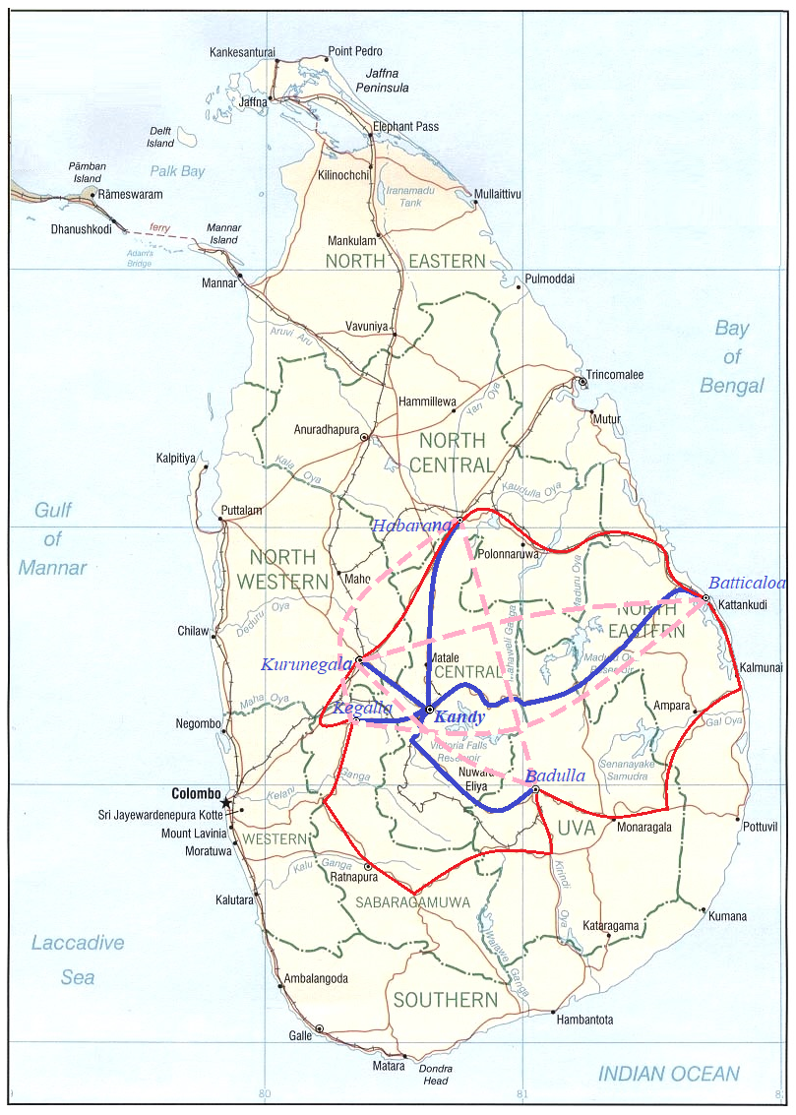
Nodal analysis is like travelling between places, always starting from a central point, like Kandy
Kegalla, Kurunegala, Habarana, Batticaloa, Badulla
Mesh analysis is like travelling between places, without having a central point but between all places
Kegalla-Kurunegala, Kegalla-Habarana,
Kegalla-Batticaloa, Kegalla-Badulla,
Kurunegala-Habarana, Kurunegala-Batticaloa, Kurunegala-Badulla, Habarana-Batticaloa,
Habarana-Badulla, Batticaloa-Badulla

Slide 23
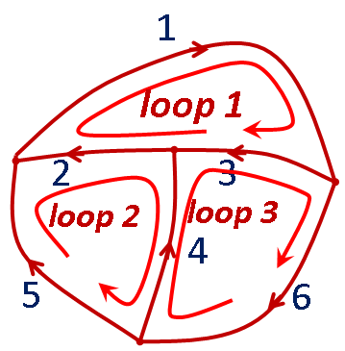
Mesh Analysis
Eliminate the branch voltages from the equations.
Using Kirchoff’s current law reduce remaining currents to minimum.
Apply Kirchoff’s voltage law for solution.
Define a set of mesh currents,
.
Branch currents
related to mesh currents
by an algebraic summation.
(4)

Slide 24
Eliminate V_{b} from the equations,
Pre-multiply equation (3) by [B]^{t}.
from equation (2), [B]^{t} V_{b} = 0.
Also
∴
[B]^{t} V_{b} = 0 → sum of voltages around a loop is zero.
i.e. [B]^{t} V_{b} → sum of voltages around a loop.
∴ [B]^{t} E_{gb} → sum of source voltages around a loop.
Defined as mesh source voltage vector E_{gm} .

Slide 25
i.e. E_{gm} = [B]^{t} E_{gb}
∴ E_{gm} =
where [Z_{m}] =
corresponds to l equations
[B] also known as the tie-set matrix
(as its elements tie the loop together)
Unknowns are l values of current I_{m}
Original 2b equations and 2b unknowns reduced to
l equations and l unknowns.

Slide 26
Elements of [Z_{m}] can be obtained either from above mathematics, or by inspection as follows.
z_{jj} = self impedance of mesh j
= sum of all branch impedances in mesh j
z_{jk} = mutual impedance between mesh j and mesh k
= sum of all branch impedances common to mesh j and mesh k and traversed in mesh direction
− sum of all branch impedances common to mesh j and mesh k, and traversed in opposite direction
e_{j} = algebraic sum of the branch voltage sources in mesh j in mesh direction.

Slide 27
Example 1
j20 Ω
20 Ω
j6 Ω
E₁
100∠0⁰ V
E₂
100∠30⁰ V
10 Ω
-j120 Ω
10 Ω
Solve the circuit using Mesh matrix analysis.
Work from first principles.
Solution
Number the branches and the loops.

Slide 28
i₁
j20 Ω
i₄
20 Ω
i₆
j6 Ω
i₅
i₂
i₃
–j120 Ω
10 Ω
E₁
100∠0⁰ V
10 Ω
E₂
100∠36.87⁰ V
I₁
I₂
I₃
Write the loop currents in terms of the branch currents.
i₁ = I₁
i₂ = – I₃
i₃ = I₁ – I₂
i₄ = I₂
i₅ = I₂ – I₃
i₆ = I₃
or
in matrix form

Slide 29
This gives the Branch-Mesh incidence matrix [B].
Mesh–Branch incidence matrix [B]^{t} can also independently by writing the relation between the mesh direction and the branch direction.
Notice that this corresponds to the transpose of the earlier written matrix.

Slide 30
Vector of branch source voltages is
Branch impedance matrix is

Slide 31
E_{gm} = [B]^{t} E_{gb} , and [Z_{m}] = [B]^{t} [Z_{b}] [B]
, E_{gm} =

Slide 32
=
Both E_{gm} and Z_{m} could have been written by inspection.
Thus
=
Equations may be solved by inversion or otherwise.

Slide 33
Δ = (1220 – j2220)×(–j100) + (720 – j2400) ×(j120) + (–j1200) ×0
= – j122000 – 222000 + j 86400 + 288000
= 66000 – j 35600 = 74989∠-28.34º
I₁ = (122000 – j 222000 + 0 + j 96000 – 72000)/74989∠-28.34º
= (50000 – j 126000)/ 74989∠-28.34º
= 135558∠-68.36º/74989∠-28.34º = 1.808∠-40.02º A
[Note: Inversion has not been checked so answers may be in error.]
Currents I₂ and I₃ can be similarly determined.
The branch currents i₁, i₂, ..... may then be determined from the matrix equation.
[Normally branch 6 would have been marked as part of branch 2]

Slide 34
Nodal Analysis
Eliminate branch currents from equations.
Reduce number of remaining voltages to a minimum using Kirchoff’s voltage law.
Apply Kirchoff’s current law.
Define a set of nodal voltages,
1
node
2
node
1
2
3
node
3
which are node pair voltages (i.e. voltage across a pair of nodes)
Branch voltages
4
5
6
are related to nodal voltages
ref. node
by
(5)
[A] too does not have the reference node.
Pre-multiply equation (3)* by [A]^{t}.

Slide 35
from equation (1), [A]^{t} I_{b} = 0 .
Substituting from (5)
I_{gN} = [Y_{N}]V_{N}
where
, and
Source nodal current vector I_{gN} and the nodal admittance matrix [Y_{N}] could be written by inspection.

Slide 36
y_{ii} = sum of all branch admittances incident at node i
y_{ij} = negative of the sum of all branch admittances connecting node i and node j .
Reason for negative sign can be understood as follows:
i_{k} = y_{k} v_{k} = y_{k} (V_{i} – V_{j})
At any node i,
injected current I_{gi} = Σ i_{k} = Σ y_{k} (V_{i} – V_{j})
y_{k}
i_{k}
i
v_{k}
j
for all j
Since V_{i} is a constant for a given i,

Slide 37
corresponds to nodal equation
As in the case of mesh analysis,
I_{gN} = [Y_{N}]V_{N}
is first solved to give V_{N} and the branch voltages
and branch currents then obtained using the matrix equations.

Slide 38
Example 2
V₁
20 Ω
V₂
j6 Ω
i₁
i₄
i₂
i₅
8.575∠5.91⁰ A
i₃
j20 Ω
5∠-90⁰ A
10 Ω
-j120 Ω
10 Ω
Example 1 has been reformulated as a problem with current sources rather than with voltage sources.
[If voltage sources are present, they would first have to be converted to current sources].

Slide 39
V₁
0.05 S
V₂
i₁
i₄
i₂
i₅
8.575∠5.91⁰ A
i₃
0.0735 – j 0.00441 S
-j0.05 S
5∠-90⁰ A
0.1 S
j0.00833 S
The branch-node incidence matrix [A],
branch injected current I_{gb}, and
branch admittance matrix may be written,
with reference selected as earthed node as follows.

Slide 40
As in mesh analysis, nodal current injection vector and nodal admittance matrix may be written from first principles.
, I_{gb} =
,
Left as an exercise for you to work out.

Slide 41
This is worked by inspection.
= (–j0.05+j0.00833+0.05)(0.05+0.1+0.0735–j0.0441) – 0.05²
= (0.05 – j 0.04167)(0.2235 – j 0.0441) – 0.0025
= 0.06509∠-39.81º×0.2278∠-11.16º – 0.0025
= 0.01483∠-50.97 – 0.0025
= 0.00934 – 0.0025 – j 0.01152 = 0.00684 – j 0.01152
= 0.0134∠-59.30º

Slide 42
V₁ = (0.2278∠-11.16º×5∠-90º+0.05×8.575∠5.91º)/0.0134∠-59.3º
= (– 0.2205 – j 1.1175 + 0.4265 + j 0.04415) /0.0134∠-59.30º
= (0.2060 – j 1.0733)/0.0134∠-59.30º
= 1.093∠-79.14º/0.0134∠-59.30º
V₁ = 81.6∠-19.84º V
∴branch current i₁ =
i₁
which is the same answer (to calculation accuracy) that was obtained in example 1.

Slide 43
Conversion of Ideal sources
(a) Ideal Voltage sources to Practical Voltage sources
No impedance directly in series with voltage source
Z₃
Z₃
Z₃
Z₁
Z₁
Z₂
Z₂
E
≡
Z₁
or
E
E
E
E
E
Z₂
Z₄
Z₅
Z₄
Z₄
Z₅
Z₅
Ideal voltage sources are distributed to branches connected to one of the nodes of original ideal source.

Slide 44
Z₃
E/Z₃
Z₃
E
E/Z₁
E
E/Z₂
E
Z₁
≡
Z₁
Z₂
Z₂
E/Z₃
Z₄
Z₄
Z₅
Z₅
Voltage Source
Current Source
Z₃
E/Z₁
E/Z₂
≡
Z₁
Z₂
Z₄
Injected Current
Z₅
E/Z₁+ E/Z₂+ E/Z₃

Slide 45
(b) Ideal Current sources
No admittance appears directly in parallel with current source
I_{s}
I_{s}
I_{s}
≡
I_{s}
Ideal current source has been distributed around a loop connecting the two points of original source.

Slide 46
End of Presentation

